Slide 1






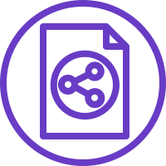


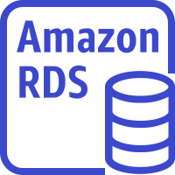
AWS Cloud
Availability Zone A
VPC
Internet gateway
Public subnet
Private subnet
Router
Classic load
balancer
NAT gateway
Auto Scaling group
Webservers
Amazon RDS instance

